Slide 1
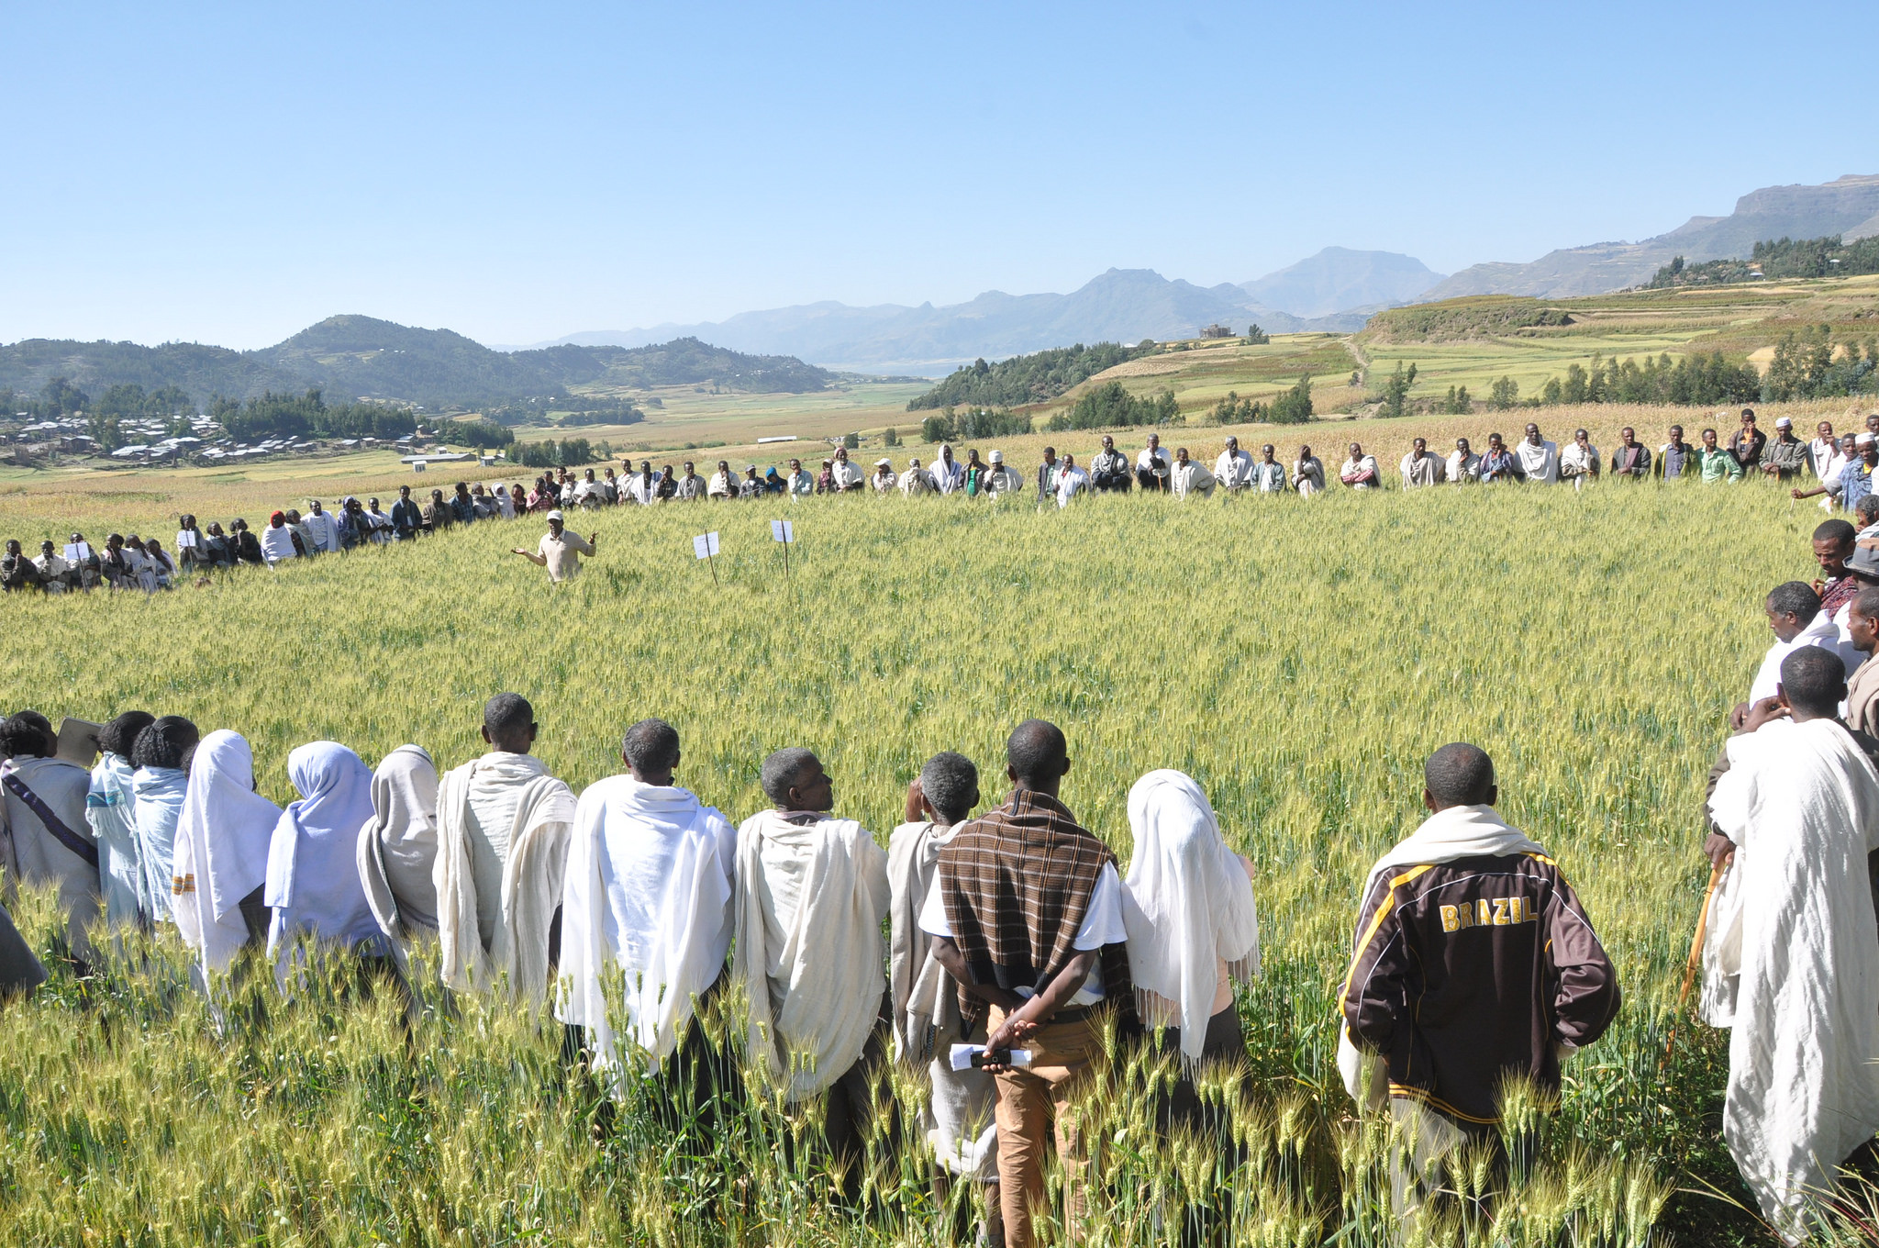
Outcome Harvesting as an Approach for Measuring Change: Experiences from USAID
USAID/FLICKR
Travis Mayo
Evaluation Specialist
USAID/PPL/LER

Slide 2
Outcome Harvest and Measuring Change
Why do we have problems measuring the outcomes of training programs?
Why is the Outcome Harvesting approach a potential solution?
What exactly is Outcome Harvesting?
How has USAID used Outcome Harvesting, a case study
How can you apply it?
Notes:
Disclosure to add, OH is tested in USAID, we find it promising but have not used it extensivley

Slide 3
Kirkpatrick 4-Level Training Evaluation Model
Level 1
REACTION
Did they like it?
Level 2
LEARNING
Did they learn it?
Level 3
BEHAVIOR
Do they use it?
Level 4
RESULTS
Did it improve results?
Notes:
Get right into it - when we think about evaluating training programs, the first thought for many is Kirkpatricks 4 levels
And lets be honest about where the problems are in evaluation, and its not at the first two levels

Slide 4
Kirkpatrick 4-Level Training Evaluation Model
Level 1
REACTION
Did they like it?
Level 2
LEARNING
Did they learn it?
Level 3
BEHAVIOR
Do they use it?
Level 4
RESULTS
Did it improve results?
Notes:
We have the most problems in evaluation when it comes to measuring changes in both use, but particularly in seeing if our trainings lead to improved results. The big so what question tacked onto all of our training theories of change. Why are we doing the training at the end of the day? To achieve higher level results.
Now the main point I want to make in this presentation is that the evaluation methods and approaches you use to answer these higher level results is not only dependent on your questions, its also dependent on the level of uncertainty that your program is dealing with. Let’s unpack this.

Slide 5
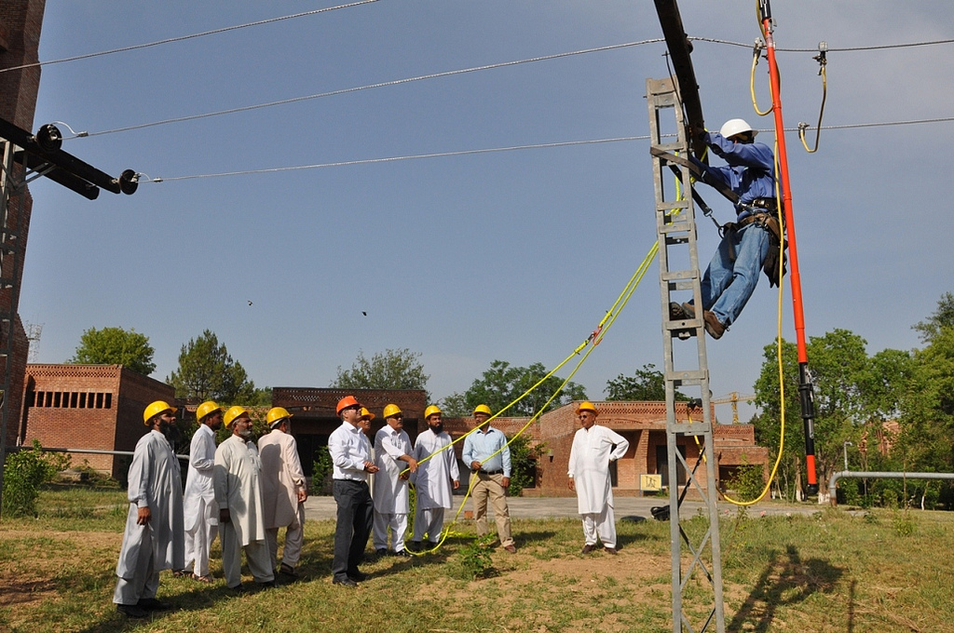
We have a challenge in evaluating training programs when:
We’re trying to find out how knowledge was used
We trying to find out if our training is leading to improved results

Slide 6
We have a challenge in evaluating training programs when:
We’re trying to find out how knowledge was used
We trying to find out if our training is leading to improved results
Why?
We often don’t know how exactly people will use our training
Its difficult to show how our training contributed to higher level changes
Notes:
Not ALL training programs have these challenges, but some do, why?

Slide 7
All Training Programs are Not Created Equal
USAID/FLICKR

Slide 8
The Making of a Training Program
Inputs
Curriculum
Output
Outcome
Participants use this knowledge after leaving the training
Facilitators
Budget
Participants have new skills or knowledge
Impact
The world has become a better place i.e. you’ve achieved your ‘so what’
Notes:
Here what out TOC’s generally look like

Slide 9
The Making of a Training Program
Inputs
Curriculum
Output
Outcome
Participants use this knowledge after leaving the training
Facilitators
Budget
Participants have new skills or knowledge
Impact
The world has become a better place
Level 1
REACTION
Did they like it?
Level 2
LEARNING
Did they learn it?
Level 3
BEHAVIOR
Do they use it?
Level 4
RESULTS
Did it improve results?
Notes:
Lets go back to this, why do we sometimes have such a hard time measuring outcomes and impacts? Here’s what our TOC looks like next to Kirkpatrick

Slide 10
The Making of a Training Program
Inputs
Curriculum
Output
Outcome
Participants use this knowledge after leaving the training
Facilitators
Budget
Participants have new skills or knowledge
Impact
The world has become a better place
Level 1
REACTION
Did they like it?
Level 2
LEARNING
Did they learn it?
Level 3
BEHAVIOR
Do they use it?
Level 4
RESULTS
Did it improve results?
Notes:
Here’s where we have the real problem, I’m making an assumption here that our biggest challenges are not at the lower levels, but rather at these higher outcome levels.

Slide 11
The unMaking of a Training Program
Inputs
Curriculum
Facilitators
Budget
Participants have new skills or knowledge
Output
Participants use this knowledge after leaving the training in the way you intended
Participants never use the knowledge
Participants use this knowledge after leaving the training in a way you never expected
Notes:
The truth is, when we get to our higher levels of outcomes our TOC turn into assumptions and wishful thinking - in reality, there are multiple possible outcomes feasible

Slide 12
The unMaking of a Training Program
Curriculum
Facilitators
Budget
Inputs
Output
Participants have new skills or knowledge
Participants use this knowledge after leaving the training in the way you intended
World is a better place
Notes:
In this slide talk through the example of a DG training for youth, training them on the democratic process and understanding who candidates are and their policies before voting. Outcomes of training can vary, could be that youth engage more in the democratic process, good job! Or, youth could become completely disenfranchised by learning about their candidates and choose to start a revolution. Or, it could inspire them to start their own NGOs to assist more youth in understanding the democratic process, it could even inspire them to become politicians. Or, they really don’t care about politics, the training doesn’t effect their life at all. The world will still change but it has nothing to do with your training

Slide 13
The unMaking of a Training Program
Curriculum
Facilitators
Budget
Inputs
Output
Participants have new skills or knowledge
Participants use this knowledge after leaving the training in a way you never expected
Participants use this knowledge after leaving the training in the way you intended
World is a better place
World is in a much better place
Oh no….what have we done?
Notes:
In this slide talk through the example of a DG training for youth, training them on the democratic process and understanding who candidates are and their policies before voting. Outcomes of training can vary, could be that youth engage more in the democratic process, good job! Or, youth could become completely disenfranchised by learning about their candidates and choose to start a revolution. Or, it could inspire them to start their own NGOs to assist more youth in understanding the democratic process, it could even inspire them to become politicians. Or, they really don’t care about politics, the training doesn’t effect their life at all. The world will still change but it has nothing to do with your training

Slide 14
The unMaking of a Training Program
Curriculum
Facilitators
Budget
Inputs
Output
Participants have new skills or knowledge
Participants never use the knowledge
Participants use this knowledge after leaving the training in a way you never expected
Participants use this knowledge after leaving the training in the way you intended
World is a better place
World is in a much better place
Oh no….what have we done?
World gets better or worse, but for reasons that have nothing to do with your training
Notes:
In this slide talk through the example of a DG training for youth, training them on the democratic process and understanding who candidates are and their policies before voting. Outcomes of training can vary, could be that youth engage more in the democratic process, good job! Or, youth could become completely disenfranchised by learning about their candidates and choose to start a revolution. Or, it could inspire them to start their own NGOs to assist more youth in understanding the democratic process, it could even inspire them to become politicians. Or, they really don’t care about politics, the training doesn’t effect their life at all. The world will still change but it has nothing to do with your training

Slide 15
The Making of a Training Program
Inputs
Curriculum
Output
Outcome
Participants use this knowledge after leaving the training
Facilitators
Budget
Participants have new skills or knowledge
Impact
The world has become a better place i.e. you’ve achieved your ‘so what’
Traditional Evaluation methods generally focus on a linear pathway of results along a predetermined logic model

Slide 16
The unMaking of a Training Program
Curriculum
Facilitators
Budget
Inputs
Participants have new skills or knowledge
Outcome Harvest assumes there are multiple outcomes, both known and unknown
Output
Participants never use the knowledge
Participants use this knowledge after leaving the training in a way you never expected
Participants use this knowledge after leaving the training in the way you intended
World is a better place
World is in a much better place
Oh no….what have we done?
World gets better or worse, but for reasons that have nothing to do with your training
Notes:
In this slide talk through the example of a DG training for youth, training them on the democratic process and understanding who candidates are and their policies before voting. Outcomes of training can vary, could be that youth engage more in the democratic process, good job! Or, youth could become completely disenfranchised by learning about their candidates and choose to start a revolution. Or, it could inspire them to start their own NGOs to assist more youth in understanding the democratic process, it could even inspire them to become politicians. Or, they really don’t care about politics, the training doesn’t effect their life at all. The world will still change but it has nothing to do with your training

Slide 17
Outcome Harvest is useful if: You’re interested in learning about achievements rather than activities, and about effects rather than implementation If you’re working in a complex programming context where relations of cause and effect are not fully understood
Notes:
To point one, this is the difference on the kirkpatrick levels, if you’re interested in the first levels, which is perfectly OK, OH may not be the best fit, but if you’re focused on the higher levels, this could help
To point 2: Conventional monitoring and evaluation aimed at determining results compares planned outcomes with what is actually achieved. In complex environments, however, objectives and the paths to achieve them are largely unpredictable and predefined objectives and theories of change must be modified over time to respond to changes in the context. Outcome Harvesting is especially useful when the aim is to understand how individual outcomes contribute to broader system-wide changes. Advocacy, campaigning, and policy work are ideal candidates for this approach.

Slide 18
What is Outcome Harvesting?
The evaluator gleans information from reports, personal interviews, and other sources to document how a given program or initiative has contributed to outcomes. These outcomes can be positive or negative, intended or unintended, but the connection between the initiative and the outcomes should be verifiable
Outcome Harvesting does not measure progress towards predetermined outcomes or objectives, but rather collects evidence of what has been achieved, and works backward to determine whether and how the project or intervention contributed to the change
Notes:
The evaluator gleans information from reports, personal interviews, and other sources to document how a given program or initiative has contributed to outcomes. These outcomes can be positive or negative, intended or unintended, but the connection between the initiative and the outcomes should be verifiable
Outcome Harvesting does not measure progress towards predetermined outcomes or objectives, but rather collects evidence of what has been achieved, and works backward to determine whether and how the project or intervention contributed to the change

Slide 19
Six Fundamental Steps to an Outcome Harvest
Design: Agree evaluation questions and what information is to be collected
Gather data: Evaluator gathers information about changes that have occurred and how the training contributed to these changes. Information about outcomes may be found in documents or collected through interviews, surveys, and other sources.
Write outcome descriptions: A concise, less than one page description is written for all identified outcomes. Outcome descriptions can undergo a classification process and/or have additional information incorporated from other stakeholders
Notes:
1. level of detail and specificity
2. Reported (and validated) observations such as progress reports, evaluations, and case studies. Direct critical observation, for example, what is seen in writing, heard during
telephone conversations, or observed during a field visit. Engagement with change agents can be accomplished through surveys, questionnaires, or interviews delivered through a variety of means including paper, online,email, telephone, or face-to-face. It can also be accomplished in workshop or focus-group settings.
3. To qualify as outcomes, attitudinal changes such as increases in awareness, knowledge, and commitment or dedication require evidence of associated changes in behavior, relationships, actions, policies, or practices. Thus, a harvester seeks observable changes that can be verified. Important to focus on Seeking attribution rather than contribution. Challenge: Failure to report negative outcomes. A change agent may inadvertently contribute to changes that significantly detract from, undermine, or obstruct a desirable result. When self-reporting, change agents are less likely to recall, track, document, and report negative outcomes

Slide 20
Six Fundamental Steps to an Outcome Harvest
Substantiate: Obtain the views of independent individuals knowledgeable about the outcome(s) and how they were achieved; this validates and enhances the credibility of the findings.
Analyze and interpret: Organize outcome descriptions through a database to make sense of them, analyze and interpret the data, and provide evidence-based answers to the useful harvesting questions
Support use of findings: Drawing on the evidence-based, actionable answers to the useful questions, propose points for discussion to users, including how the users might make use of findings.
Notes:
4. To substantiate the outcome descriptions, the harvester obtains testimonies and feedback from independent substantiators. It is important to keep in mind that greater claims of change are likely to required greater evidence and substantiation. Regardless of the evidence provided by change agents, the outcomes and contributions they report have a strong subjective dimension. The harvester seeks to triangulate the sources of information regarding the outcome; the change agent’s reports to external evaluators and communication with representative(s) of the change agent other than the report writer are the usual sources. In addition, the perspectives of third parties will enhance the credibility of the harvest. Substantiation provides this perspective.
5. Analysis involves the identification of patterns and processes among clusters of outcomes, and often focuses on corresponding theories of change. Depending on the program context and monitoring or evaluation purpose, a harvester may choose to analyze outcomes and answer useful questions at one of the three following levels:
▪ For each outcome
▪ For all the outcomes of a single change agent
▪ For an overarching program or systems change initiative to which the various
outcomes of multiple change agents relate
Making sense” of outcomes is tied directly to how findings will be used, which affects how the harvester will answer the useful questions. The interpretive lens may be focused exclusively on the harvest user´s vision and mission, institutional goals, theory of change, or strategic or annual plans. On the other hand, the field of vision may be broad, allowing the harvesters to apply their theoretical knowledge or professional judgement and expertise to make sense of the outcomes.

Slide 21
How was OH used in USAID
Case Study - Strengthen Civil Society Sector in Iraq
Background: use of various activities and grants to local CSOs to increase democratic engagement of citizens and enhance CSO’s institutional capacity
Questions asked (Step 1 Design):
To what extent have we contributed to increased civic participation?
What do the outcomes we’ve achieved imply for how other programs should be designed for societies in transition?
Notes:
100 civil society organizations (CSOs) supported by the BPCS and the six BPCS consortium members (together hereafter referred to as the “BPCS partners”).
On the one hand, the Mercy Corps team in Iraq required evidence of change that would help understand the results of the program and enable it to communicate this internally and externally. On the other, Mercy Corps aimed to inform future programming by better understanding the process of change or the causal linkages between civil society programming and improvements in democracy and governance. The second is to test the efficacy of Outcome Harvesting as a methodology that could be used by Mercy Corps for other purposes.
Currently being used in : USAID/Mali’s Feed the Future program: OS Partners Inc., a small, woman-owned, disadvantaged business, is currently implementing the Impact Evaluation and Quantitative Population-Based Surveys for USAID/Mali’s Feed-the-Future (FTF), Cereal Value Chain (CVC) Activity

Slide 22
How was OH used in USAID
Case Study - Step 1: Design
The criteria of what constitutes an “outcome” will be understood as an observable change in “behavior” writ large: a change in the relationships, actions, activities, policies, or practices of an Iraqi citizen or civic group, community or organization or in an Iraqi governmental entity.
The standard will be that these changes are sufficiently concrete and specific so that they can be verified
Notes:
The criteria of what constitutes an “outcome” in the BPCS context will be understood as an observable change in “behavior” writ large: a change in the relationships, actions, activities, policies, or practices of an Iraqi citizen or civic group, community or organization or in an Iraqi governmental entity.
Currently being used in : USAID/Mali’s Feed the Future program: OS Partners Inc., a small, woman-owned, disadvantaged business, is currently implementing the Impact Evaluation and Quantitative Population-Based Surveys for USAID/Mali’s Feed-the-Future (FTF), Cereal Value Chain (CVC) Activity

Slide 23
How was OH used in USAID
Case Study – Step 2: Gather Data
Outcomes were harvested from:
• Quarterly Reports
• Weekly Reports
• Performance Monitoring Plan
• Baseline and Midline Survey reports and data
• advocacy assessment reports
• Previous M&E efforts
• Sub-partner final reports
• Draft external project performance evaluation report
Notes:
From reports, previous evaluations, press releases and other documentation, the two in-country evaluators will identify per BPCS partner up to 10 most significant potential positive outcomes, and up to 3 undesirable or negative outcomes, and BPCS’s contribution to them. (See Annex 3: BPCS partners per co-evaluator.) The influence of BPCS can range from inspiring and encouraging, facilitating and supporting, to persuading or pressuring the social actor to change.

Slide 24
How was OH used in USAID
Case Study - Step 3: Write Outcome Descriptions
Engage with key sources of information in formulating outcome descriptions
The evaluators communicate directly with sources. The information sources will often consult with others inside or outside their organization who are well-informed about outcomes to which they have contributed.
Notes:
After extracting outcomes from documentation, harvester(s) virtually engage with knowledgeable and motivated BPCS consortium staff to complement the information available in the files and identify and formulate additional outcomes. This two-step approach — document review and consultation with primary sources — has proven to be the most efficient as well as effective means to collect outcome data in the Outcome Harvesting mode. Harvesting is highly participatory not on principle but for a basic methodological reason: you have to be informed by the people who are closest to the ‘action’; they know best what they are achieving and, furthermore, are motivated to report on their achievements. They serve as sources knowing that the information they give will a) be public and b) may be verified with independent third parties. We consider that BPCS consortium staff is best placed to identify and formulate the outcomes the BPCS partners themselves have influenced.
Thus, the Iraq-based co-evaluators will engage directly with the BPCS implementing staff and consortium partner team members who are a) knowledgeable about the changes BPCS partners have influenced in Iraqi civil society and government, b) motivated to share what they know, c) willing to go on the record with their knowledge, and d) available to devote several hours to engaging with the evaluation team. With the support of the co-evaluators, the approximately 20 BPCS consortium staff will review the outcome descriptions based on the document review, and identify and formulate additional significant outcomes up to a maximum of 10. BPCS consortium staff may telephone CSOs to obtain more detailed information on specific outcomes.
The co-evaluators will engage with BPCS consortium staff in the period 22 August through 17 September, now with the International Outcome Harvest Consultant supporting through virtual coaching through email and Skype.
a) Who changed, what they changed, when and where?
b) How did the BPCS partner influence the change?
c) Why was the change important for strengthening Iraq’s transition to participatory democracy as indicated by changes in civic engagement or government openness?

Slide 25
How was OH used in USAID
Case Study - Step 3: Write Outcome Descriptions
a) Who changed, what they changed, when and where?
b) How did the BPCS partner influence the change?
c) Why was the change important for strengthening Iraq’s transition to participatory democracy as indicated by changes in civic engagement or government openness?
Notes:
After extracting outcomes from documentation, harvester(s) virtually engage with knowledgeable and motivated BPCS consortium staff to complement the information available in the files and identify and formulate additional outcomes. This two-step approach — document review and consultation with primary sources — has proven to be the most efficient as well as effective means to collect outcome data in the Outcome Harvesting mode. Harvesting is highly participatory not on principle but for a basic methodological reason: you have to be informed by the people who are closest to the ‘action’; they know best what they are achieving and, furthermore, are motivated to report on their achievements. They serve as sources knowing that the information they give will a) be public and b) may be verified with independent third parties. We consider that BPCS consortium staff is best placed to identify and formulate the outcomes the BPCS partners themselves have influenced.
Thus, the Iraq-based co-evaluators will engage directly with the BPCS implementing staff and consortium partner team members who are a) knowledgeable about the changes BPCS partners have influenced in Iraqi civil society and government, b) motivated to share what they know, c) willing to go on the record with their knowledge, and d) available to devote several hours to engaging with the evaluation team. With the support of the co-evaluators, the approximately 20 BPCS consortium staff will review the outcome descriptions based on the document review, and identify and formulate additional significant outcomes up to a maximum of 10. BPCS consortium staff may telephone CSOs to obtain more detailed information on specific outcomes.
The co-evaluators will engage with BPCS consortium staff in the period 22 August through 17 September, now with the International Outcome Harvest Consultant supporting through virtual coaching through email and Skype.
a) Who changed, what they changed, when and where?
b) How did the BPCS partner influence the change?
c) Why was the change important for strengthening Iraq’s transition to participatory democracy as indicated by changes in civic engagement or government openness?

Slide 26
How was OH used in USAID
Case Study - Step 4: Substantiate
Evaluators obtain the views of one or more independent people knowledgeable about the outcome, or a representative group of outcomes, and how they were achieved, to enhance the validity as well as the credibility of the findings
Notes:
Substantiation involves consulting with equally knowledgeable and authoritative but independent third parties to obtain their opinion on outcomes. Substantiation increases the credibility of the findings, but may be omitted or carried out for only a sample of outcomes. The criteria for deciding includes the need or not to of verifying the accuracy of the outcome data and obtaining a deeper understanding of outcomes by bringing in the perspectives of external actors. What will make the whole set of outcomes credible enough for the uses of the evaluation? Since all BPCS consortium staff will have been made aware that the information they provide could be subject to verification, thisat may provide sufficient credibility. Other factors influencing decisions about substantiation include time and resource limitations.
BPCS managers and the three evaluators will review the estimated 300-400 final outcomes and decide if verification is necessary, and if so, select those to be verified.
The evaluators will obtain the views of one or more individuals who are independent of BPCS but knowledgeable about one or more of the outcomes and the BPCS’s contribution. These substantiators go on record with their opinion about the outcome as formulated. If the number of outcomes that are not independently substantiated (and thus eliminated from consideration in the next step) is enough to undermine the credibility of the whole set of outcomes, then BPCS managers and the evaluators decide what to do.
The time required for substantiation depends of course on how many outcomes must be verified so that the whole set of outcomes is credible enough for Mercy Corps’ uses. Therefore, the deadline for deciding on substantiation is 17 September time and timing for substantiation is tentatively 18 September to 8 October.
Let’s set a milestone date to make this decision on how many/which outcomes to substantiate

Slide 27
How was OH used in USAID
Case Study - Step 5: Analyze and interpret
Evaluators organize outcome descriptions through a database in order to make sense of them, analyze and interpret the data and provide evidence-based answers to the useful evaluation questions
Notes:
The Iraq-based co-evaluators classify all outcomes, perhaps in consultation with the BPCS consortium staff, and with supervision by the International Outcomes Harvesting Consultant. The classifications are usually derived from the useful questions. For the expected 300-400 outcomes an Excel database will be used to store and organize the outcome descriptions so that they are manageable. The evaluation team will first facilitate a mini-workshop of key BPCS consortium staff to see what sense they make of the outcomes and how they would use the data to answer the evaluation questions. The evaluation team then interprets all the information collected, including the opinions of the BPCS team, and provides evidence-based answers to the evaluation questions in the form of a report.
The International Outcomes Harvesting Consultant and the Iraq-based co-evaluators will submit the draft evaluation report by 15 November 2015 to the BPCS team for correction of factual errors and identification of any illegibility in the report. If the BPCS team provides their feedback on the draft by 23 November, the final report will be submitted by 30 November.
Can we set tentative dates for this?

Slide 28
How was OH used in USAID
Case Study - Step 6: Support use of findings:
Evaluators propose points for discussion to harvest users grounded in the evidence-based answers to the useful questions. Discussions with users might include how they could make use of findings. The evaluators also wrap up their contribution by accompanying or facilitating the discussion amongst harvest users

Slide 29
Case Study Results
148 outcomes identified that contributed to strengthening Iraq’s transition to participatory democracy as indicated by changes in civic engagement or government openness
Only 6 undesirable outcomes identified
Notes:
Weakness in design, because project reports were used as a basis of data collection, low likelihood of negative outcomes to be discovered

Slide 30
Case Study Results
Of 148 outcomes, 31 outcomes (~20%) were substantiated
One outcome was subsequently unable to be substantiated and was removed from the data set

Slide 31
Case Study Results
Q. 1 To what extent have we contributed to increased civic participation?
Throughout the outcomes there are many instances of citizens, both as individuals or organized
in CSOs, meeting with government officials face-to-face to exchange views and negotiate action.
This was the first time for many citizens who did not previously believe that they could actually
approach government. For young people, their participation demonstrated its value to
themselves and to civil society and potentially to government too. Also noteworthy is that
government officials were open to meetings and discussions, after different degrees of prying by
civil society.
Notes:
Not the full result, one excerpt from multiple pages of data answering the question

Slide 32
What did OH accomplish for USAID
Q. 2 What do the outcomes we’ve achieved imply for how other programs should be designed for societies in transition?
The slightly greater success in sponsoring community mobilization opportunities and the promotion of volunteerism with 12 outcomes corresponding to each, is noteworthy because Iraqi CSOs are learning how to effectively reach out to others, and involve their communities in new ways.
The BPCS strategy with 67 outcomes that correspond to influencing government (or community leader) decisions was the most successful in strengthening Iraqi civil society
Civil society has been able to influence the practices of tribal and religious leaders, something that Iraqi CSOs do not tend to do, and were successful in doing so across sectarian lines

Slide 33
Why Should You Use OH for Training
Level 1
REACTION
Did they like it?
Level 2
LEARNING
Did they learn it?
Level 3
BEHAVIOR
Do they use it?
Level 4
RESULTS
Did it improve results?
Notes:
Disclosure to add, OH is tested in USAID, we find it promising but have not used it extensivley

Slide 34
How would YOU use an Outcome Harvest?
Design
Gather data
Write outcome descriptions
Substantiate
Analyze and interpret
Support use of findings
What are you evaluation questions? How would you define an outcome? Where would the outcomes be that are most important to you?
Where are the first places to collect data? What data sources do you already have that could be windows into outcomes?
Who would have the knowledge to provide context to the outcomes you discover?
Who could independently substantiate the outcomes you find?
Ideally, how would you like the outcomes you find to be categorized?
How do you envision using the data you uncover?

Slide 35
How would YOU use an Outcome Harvest?
Design
Gather data
Write outcome descriptions
Substantiate
Analyze and interpret
Support use of findings:

Slide 36
Why Should You Use OH for Training
Level 1
REACTION
Did they like it?
Level 2
LEARNING
Did they learn it?
Level 3
BEHAVIOR
Do they use it?
Level 4
RESULTS
Did it improve results?
Notes:
Disclosure to add, OH is tested in USAID, we find it promising but have not used it extensivley

Slide 37
Thank you
tmayo@usaid.gov

